Slide 1

8th Grade Math: Pre-Algebra
Unit 14, Lesson 7 Solving Problems Using Probability Volume 2, pg. 344

Slide 2


Benchmarks
MA.8.DP.2.1
Determine the sample space for a repeated experiment.
MA.8.DP.2.2
Find the theoretical probability of an event related to a repeated experiment.
MA.8.DP.2.3
Solve real-world problems involving probabilities related to single or repeated experiments, including making predictions based on theoretical probability.
volume 2, pg. 344

Slide 3
Integrated Mathematical Thinking and Reasoning Standards
MA.K12.MTR.2.1 Demonstrate understanding by representing problems in multiple ways.
MA.K12.MTR.3.1 Complete tasks with mathematical fluency.
MA.K12.MTR.7.1 Apply mathematics to real-world contexts.
volume 2, pg. 344

Slide 4

Learning Target
I can use theoretical probability to make predictions.
volume 2, pg. 344

Slide 5

Warm-Up
volume 2, pg. 344

Slide 6
14.7.1 Warm-Up: Meal Combinations
How many different meals are possible if each meal includes one main course, one side dish, and one drink?
Compare your calculations with your partner. Explain whether or not you solved the problem the same way.
Main Courses | Side Dishes | Drinks
grilled chicken | salad | milk
pasta salad | applesauce | juice
volume 2, pg. 344

Slide 7

Collaboration
volume 2, pg. 345

Slide 8

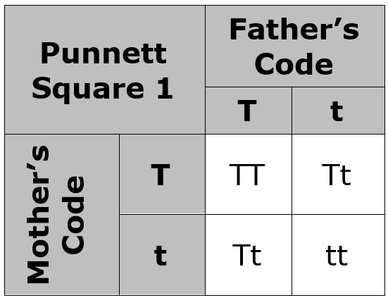
14.7.2 Collaboration: Making Predictions With Punnett Squares
Math can be used to help make sense of scientific processes. To study genetics, scientists use Punnett Squares. Punnett Squares can be used to determine what traits parents can pass on to their offspring and how likely it is that they pass on certain traits.
Consider a litter of puppies in which the father of the dogs has a short tail, and his genetic code for that is “Tt.” The mother of the litter also has a short tail with the same genetic code “Tt.” Here is how a Punnett Square can be used to determine the sample space for tails of the puppies in the litter.
volume 2, pg. 345

Slide 9
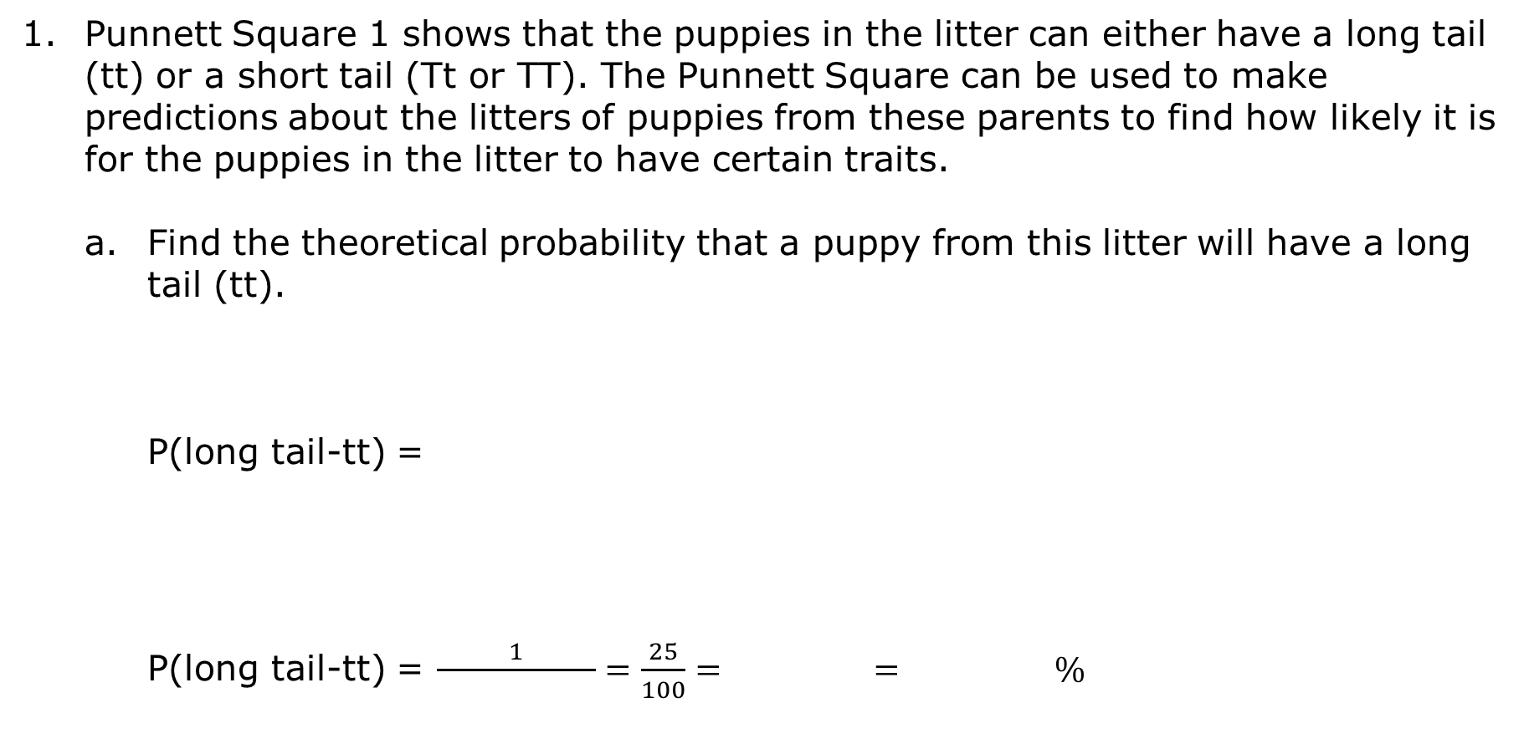
Punnett Square 1 shows that the puppies in the litter can either have a long tail (tt) or a short tail (Tt or TT). The Punnett Square can be used to make predictions about the litters of puppies from these parents to find how likely it is for the puppies in the litter to have certain traits.
Find the theoretical probability that a puppy from this litter will have a long tail (tt).
P(long tail-tt) =
P(long tail-tt) = $\frac{1}{ }=\frac{25}{100}= = \%$
the number of combinations that result in a long tail
the number of total combinations
volume 2, pg. 345

Slide 10
Find the theoretical probability that a puppy from this litter will have a short tail (TT or Tt).
volume 2, pg. 345

Slide 11
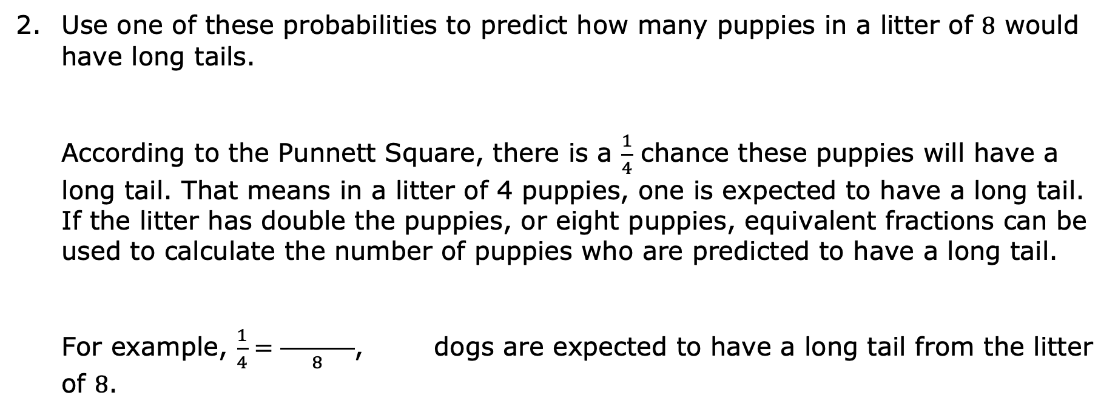
Use one of these probabilities to predict how many puppies in a litter of 8 would have long tails.
According to the Punnett Square, there is a $\frac{1}{4}$ chance these puppies will have a long tail. That means in a litter of 4 puppies, one is expected to have a long tail. If the litter has double the puppies, or eight puppies, equivalent fractions can be used to calculate the number of puppies who are predicted to have a long tail.
For example, $\frac{1}{4}=\frac{ }{8}$, dogs are expected to have a long tail from the litter of 8.
volume 2, pg. 346

Slide 12
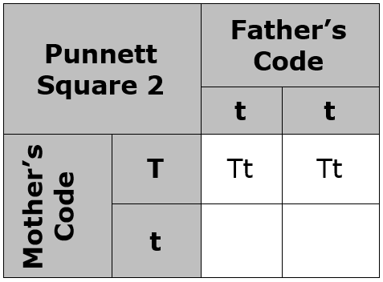
Throughout their lives, these two dogs were parents to 4 litters, a total of 28 dogs. Of these 28 dogs, how many are expected to have short tails?
_____ of the 28 dogs are expected to be born with a short tail.
Complete Punnett Square 2 to make a different kind of prediction. This Punnett Square shows the possible traits of puppies whose father’s tail code is “tt,” meaning he has a long tail, and whose mother’s tail code is “Tt,” which results in a short tail.
volume 2, pg. 346

Slide 13
What is the likelihood that these offspring will have short tails? Write the answer in decimal form.
What is the likelihood that these offspring will not have short tails? Write the answer in decimal form.
Suppose that over time these parents have 12 puppies with short tails. How many total dogs are expected for these parents to have had? Use equivalent fractions to calculate how many total puppies these two parents had over time.
volume 2, pg. 346

Slide 14
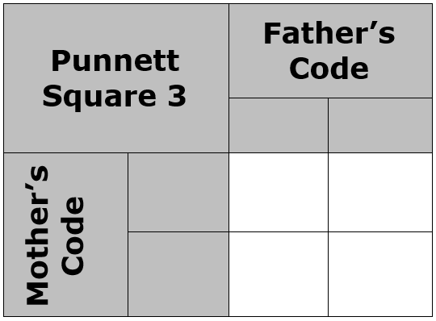
Punnett Squares can also be used to make predictions about fur patterns in a litter of kittens. The code for solid fur is “ff.” Cats with striped fur have the code “Ff” (one of each letter), and cats with splotchy fur have the code “FF.”
Use Punnett Square 3 to show the possible traits a litter of cats could have if their father has solid fur (ff) and their mother has striped fur (Ff).
volume 2, pg. 347

Slide 15
What is the likelihood that these two cats will have offspring with splotchy fur (FF)?
At a cat sanctuary, 150 cats are born to one parent with solid fur (ff) and one parent with striped fur (Ff). Explain how many of these cats you would expect to have striped fur.
volume 2, pg. 347

Slide 16
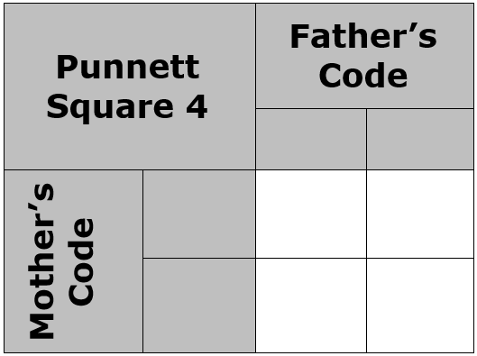
Suppose a mother cat with striped fur (Ff) and a father cat with striped fur (Ff) have 36 kittens with striped fur over the years.
Complete Punnett Square 4 to determine all possible fur patterns for their offspring.
Predict how many total kittens these parents had.
Predict the number of kittens these parents had with solid fur.
How many of these kittens are expected to have splotchy fur?
volume 2, pg. 347

Slide 17

Your Turn
volume 2, pg. 348

Slide 18
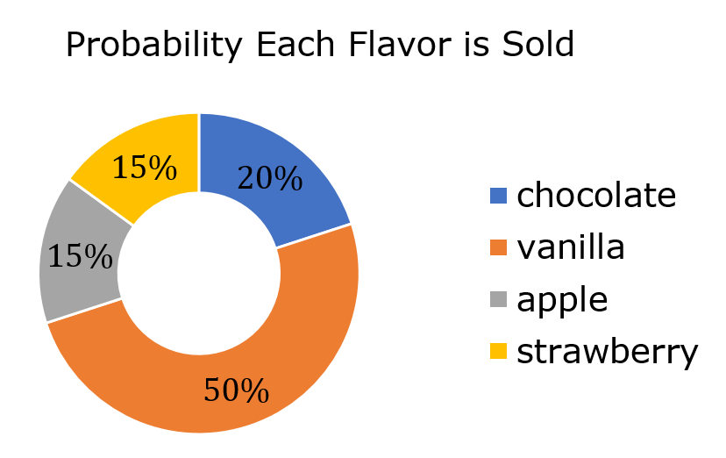
14.7.3 Your Turn!
At Alex’s Bakery, the owners keep detailed records about their sales. The graph below shows the probability that each flavor of doughnut will be purchased based on first quarter sales.
volume 2, pg. 348

Slide 19
If a total of 1,000 doughnuts are sold, predict how many of those are apple flavored.
Suppose that 107 chocolate doughnuts are sold in a day. Predict how many total doughnuts were sold this same day.
In one year, Alex’s Bakery sells about 4,000 doughnuts. Estimate how many of those doughnuts are vanilla flavored.
Darrielle picks 10 shoes out of her closet without looking. One fifth of them are blue. If there are 20 pairs of shoes in her closet, predict how many of those pairs are not blue.
volume 2, pg. 348

Slide 20

Wrap-Up
volume 2, pg. 349

Slide 21
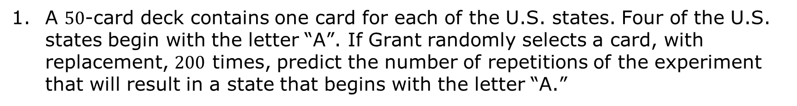
14.7.4 Wrap-Up: Ticket Out the Door
A $50$-card deck contains one card for each of the U.S. states. Four of the U.S. states begin with the letter “A”. If Grant randomly selects a card, with replacement, $200$ times, predict the number of repetitions of the experiment that will result in a state that begins with the letter “A.”
volume 2, pg. 349

